Slide 1
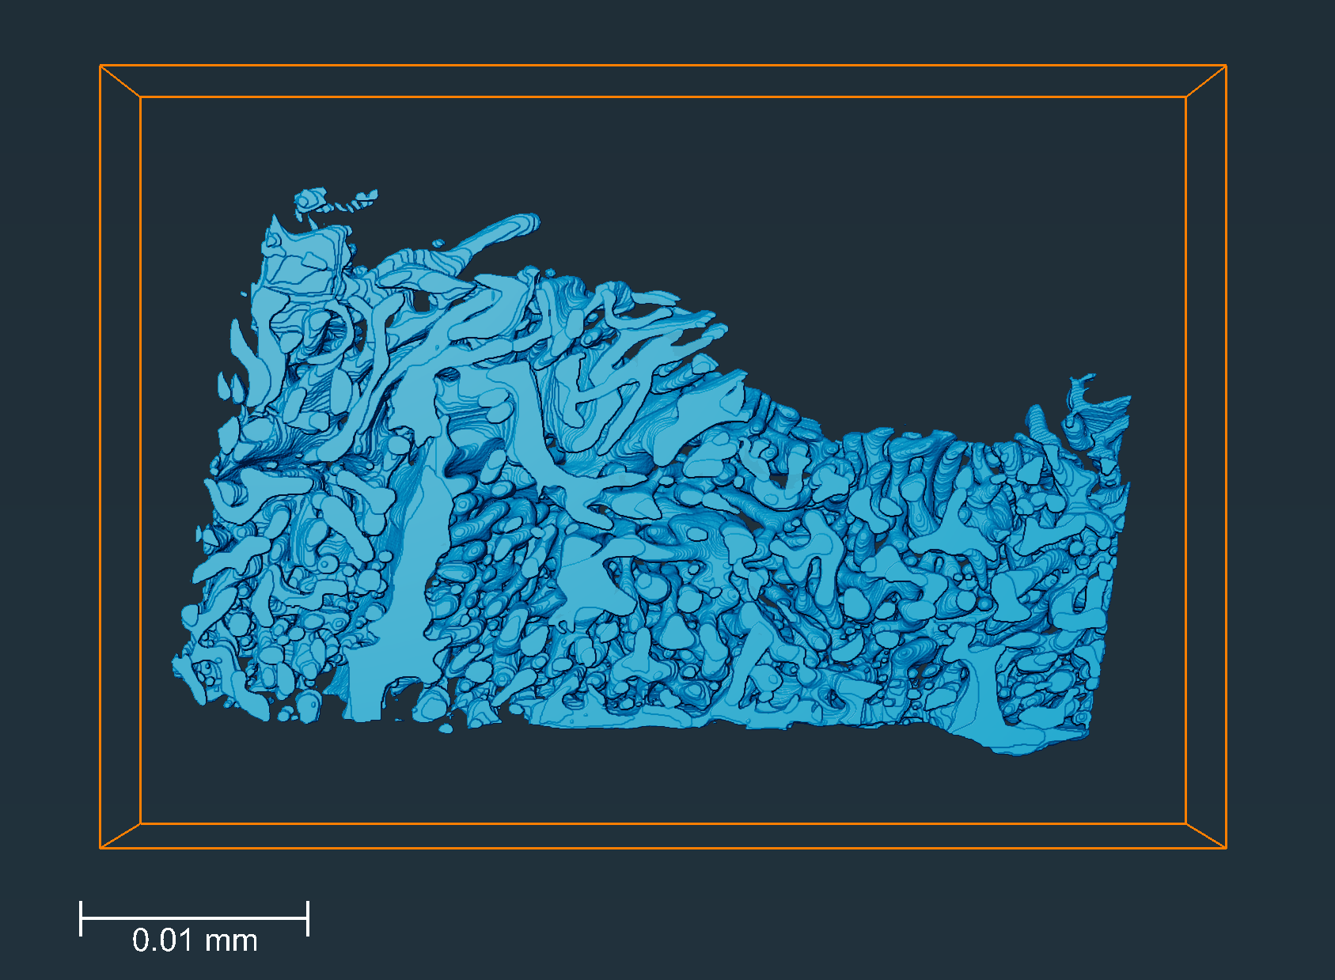
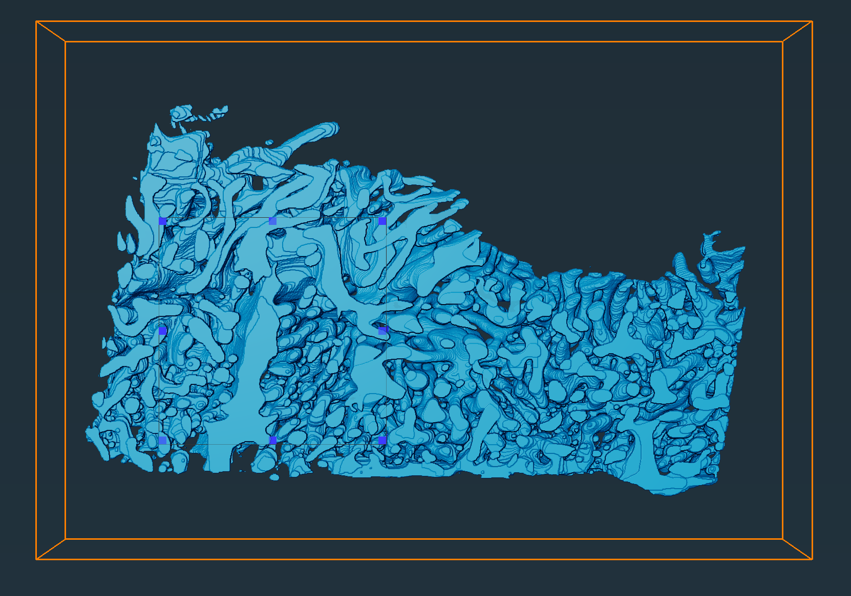
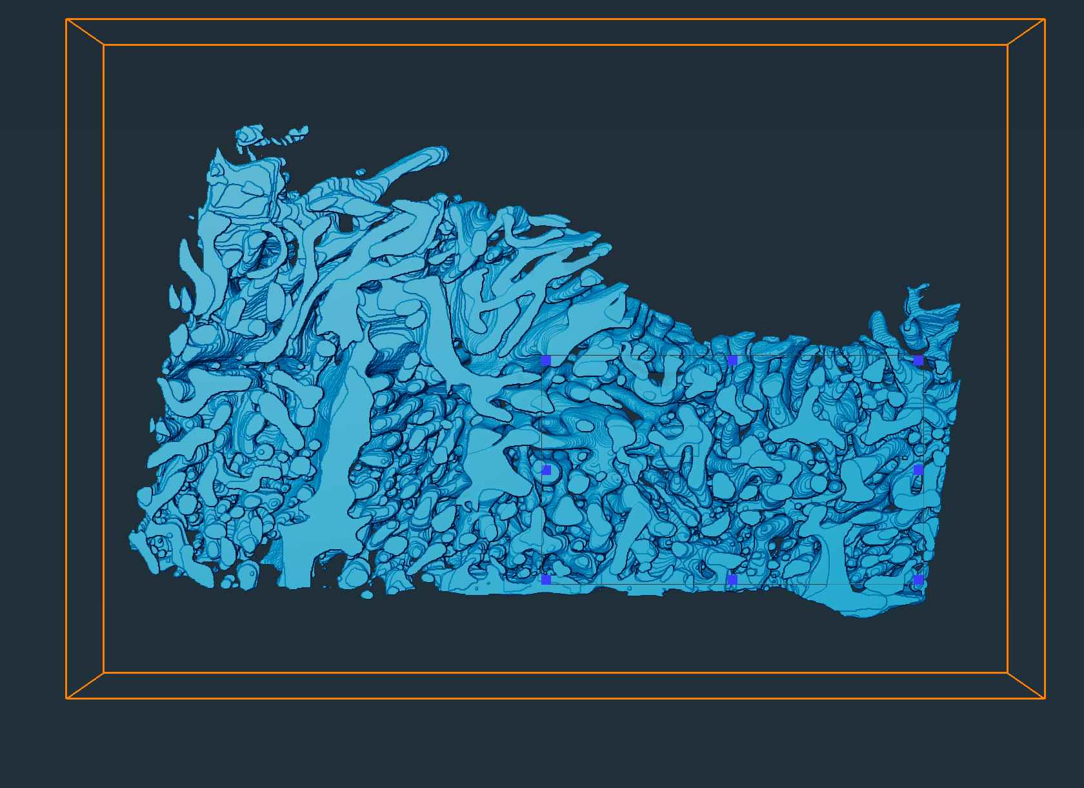
Average volume fraction: 28±2%
Volume fraction: 30.0%
35 µm
Volume fraction: 25.2%
15 µm x 15 µm x 6 µm
20 µm x 12 µm x 6 µm
y
z
x
6 µm
51 µm

